Slide 2
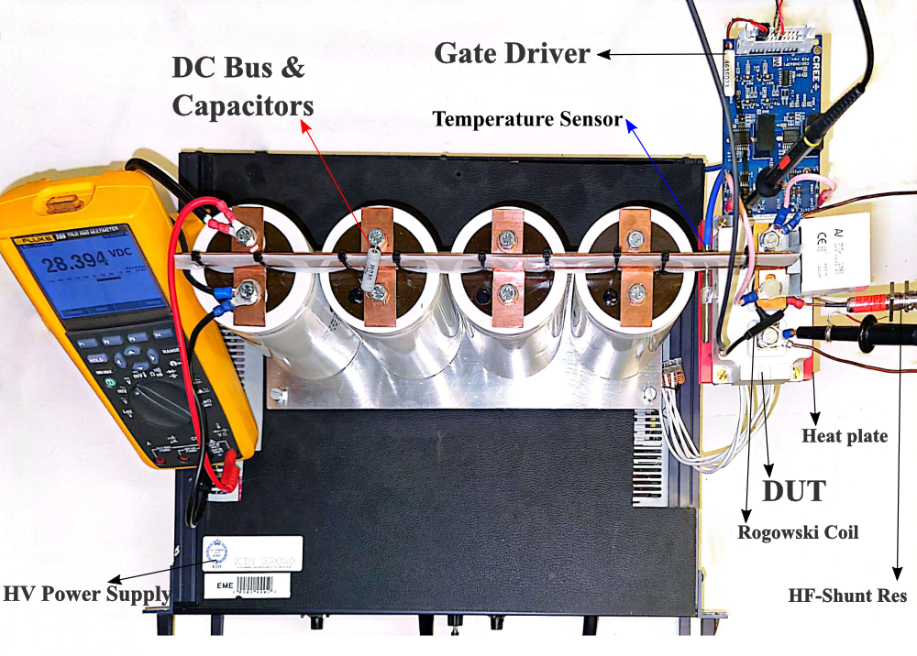
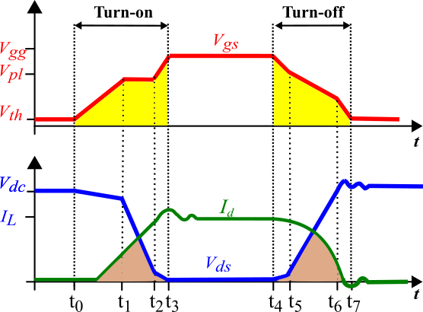
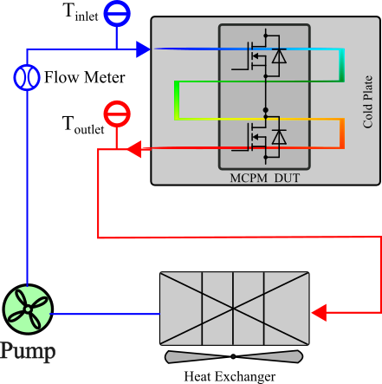
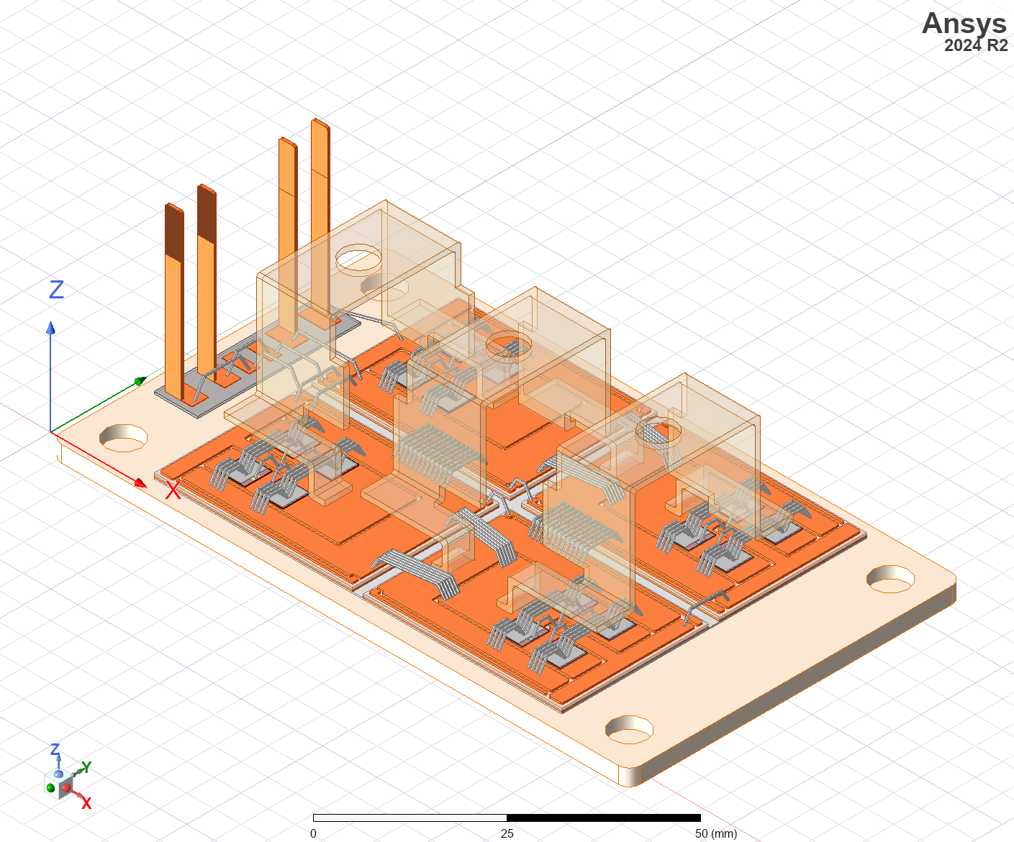
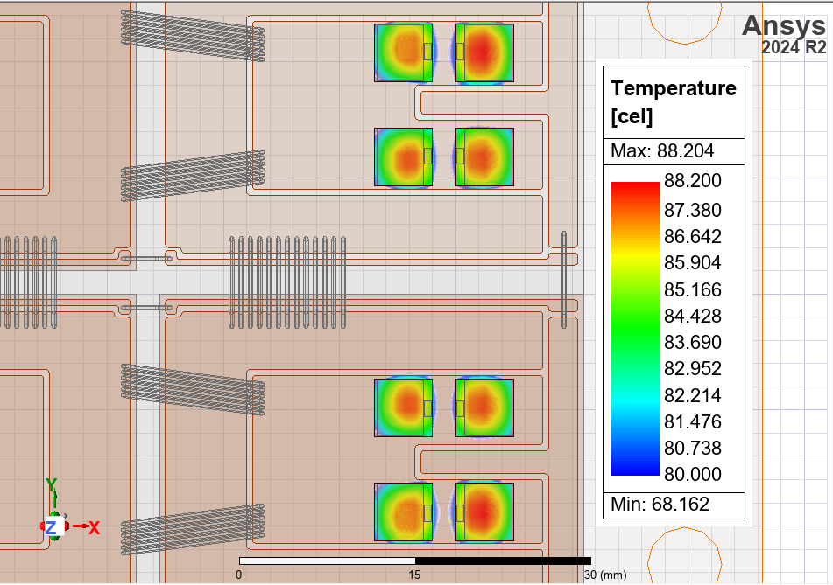
Shahriar Sarmast shsg@kth.se
Reliability Studies
Degradation studies on SiC MOSFETs
  Double pulse test setup
  FEM modeling of multichip power module
  Power cycling setup with calorimetry loss measurement capability (under construction!)
Double pulse test setup
Calorimetric loss measurement
Q3D SiC MOSFET Modeling

Slide 3
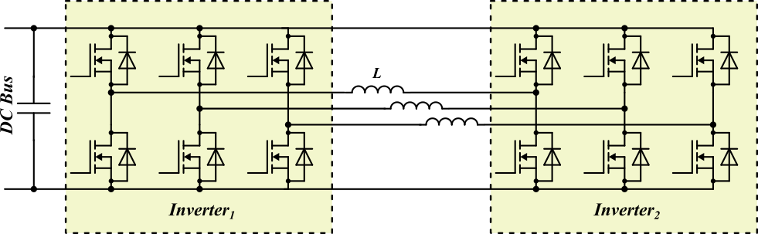
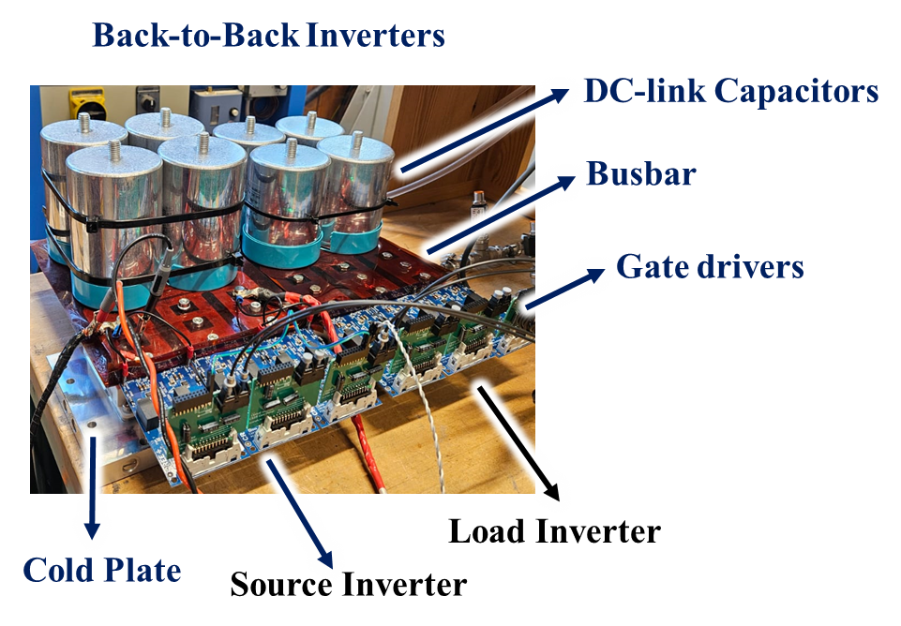
Back-to-Back Setup
Shahriar Sarmast shsg@kth.se
Optimizing the back-to-back setup to emulate the 300kW motor connected inverter.
  DC-Bus voltage increase to 1.2kV to enable the megawatt charging system for long-haul trucks.
  Calorimetric loss measurement to study remaining lifetime of the MCPMs.
  Gate driver optimization
    Current source gate driver for short transients and lower switching loss on MCPM
    High voltage

Slide 4
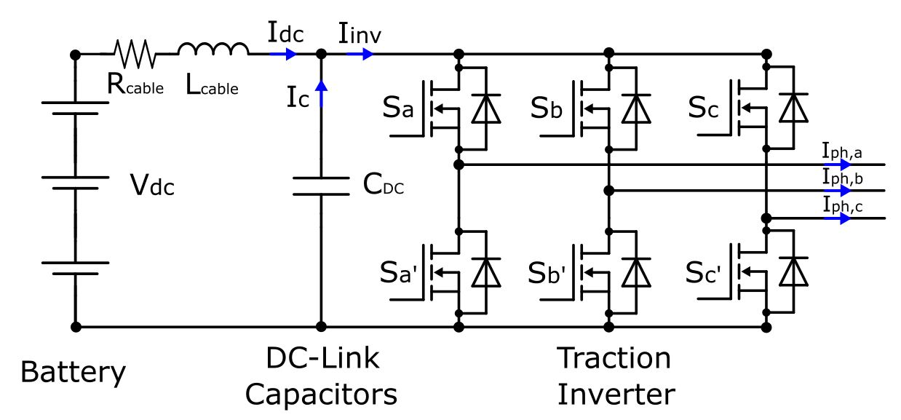
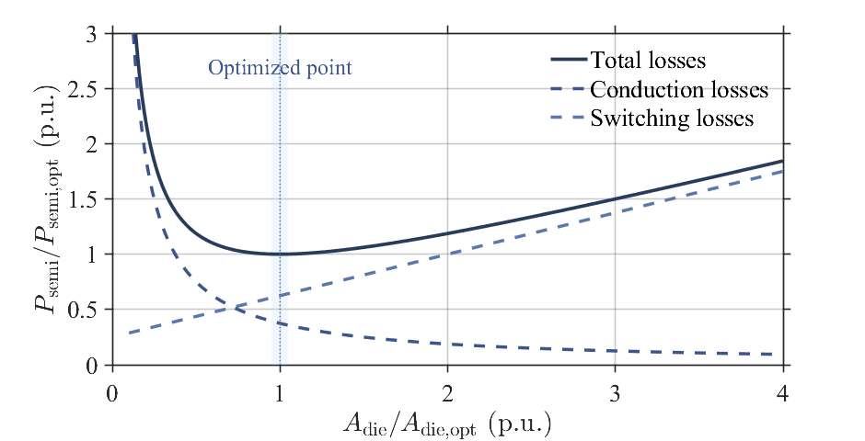
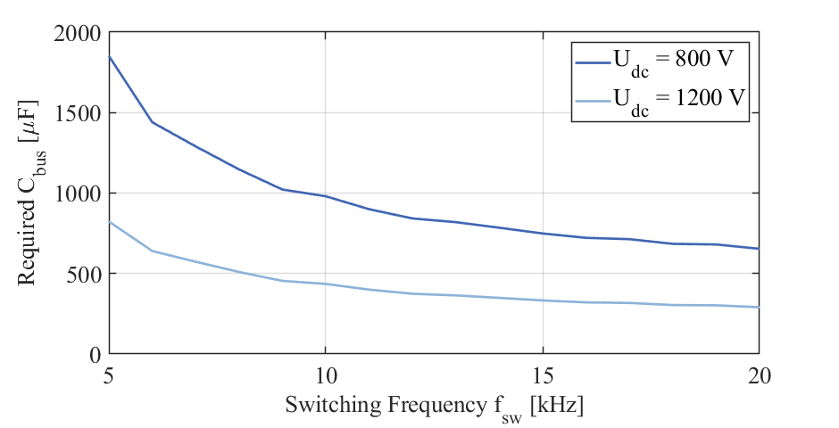
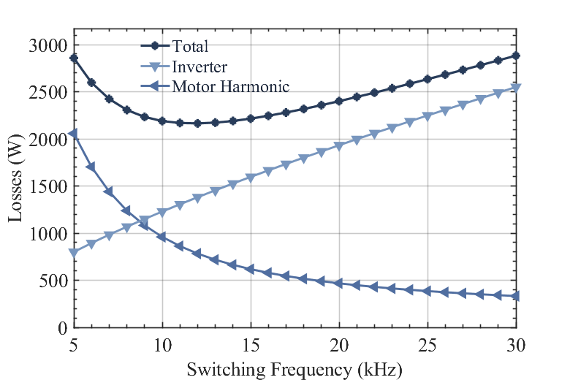
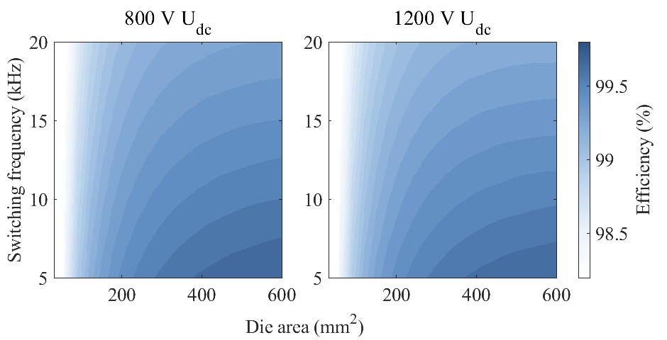
Raising the DC-Link Voltage in Traction Inverters
Transitioning to 1200 V DC-link (from 800V) reduces current by ~33 % for the same power.
Lower current → lower conduction and copper losses (~44 %).
Enables Megawatt fast charging
Two-level SiC inverter remains compact and efficient at higher voltage.
Optimal die area & switching frequency (≈ 12 kHz) selected for loss balance.
Achieves η ≈ 99.5 %, ~30 % smaller DC-link capacitor volume.
Enes Ayaz

Slide 5
“Hello, I am Enes, have been doing PHD here for two and a half year.
I work in the PowerizeD and HemiZero projects on high-voltage traction inverters, looking at the advantages of raising voltage and design tradeoffs.
Raising the DC-link voltage from 800 V to 1200 V reduces current by about one-third, which directly cuts conduction and copper losses by roughly 44%.
Lower current also enables lighter cabling and supports megawatt fast charging.
A two-level SiC inverter remains compact and efficient at 1200 V, but we need to use higher blocking voltage for the semiconductor.
Our optimisation identifies ~12 kHz as the best switching frequency, balancing conduction, switching, and motor harmonic losses.
Overall, we achieve around 99.5% efficiency and ~30% smaller DC-link capacitor volume with high voltage.
Enes Ayaz

Slide 6
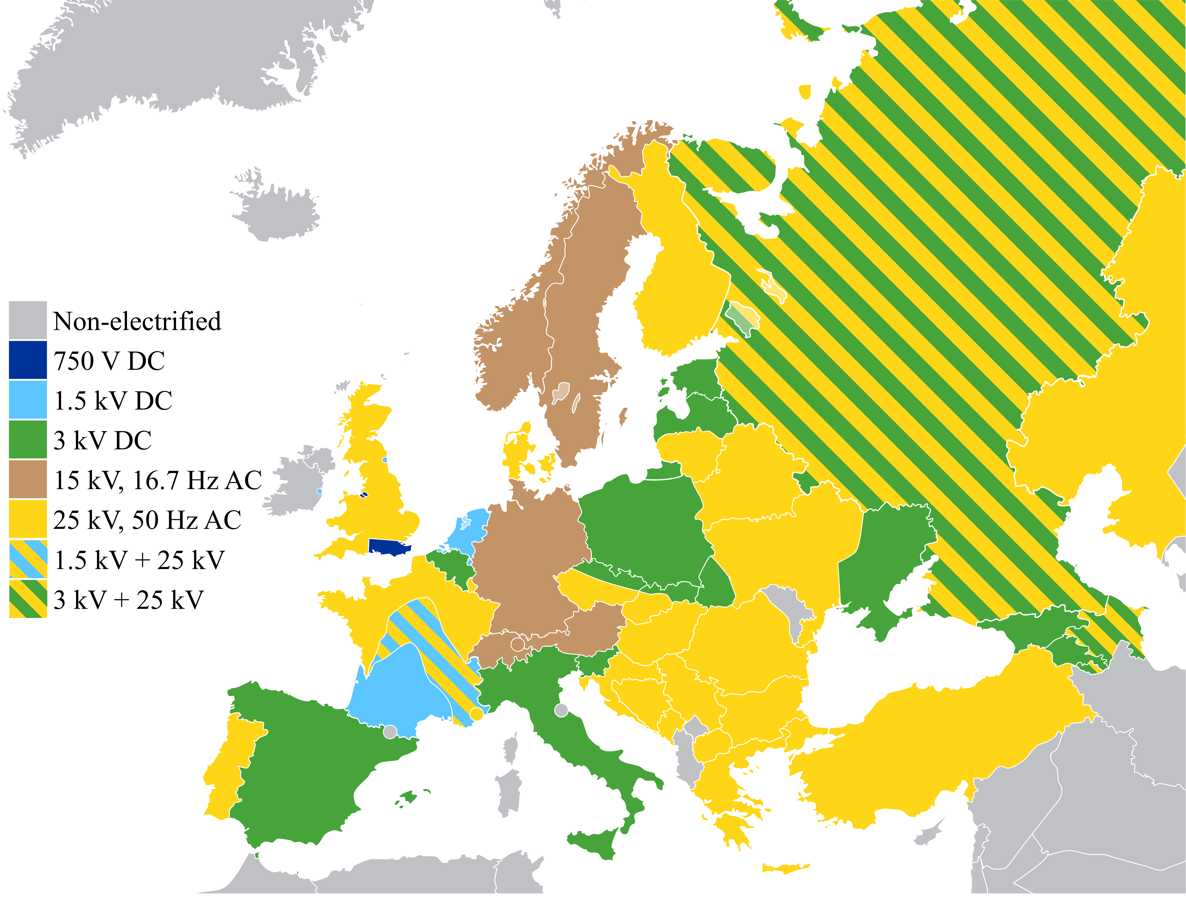
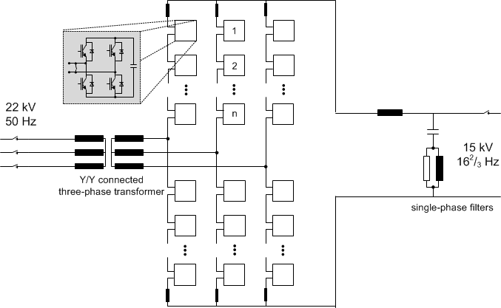
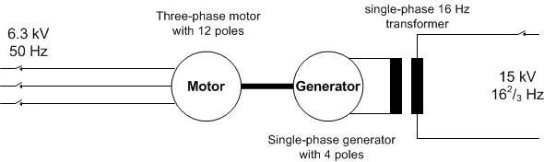
AC railway power systems
Different topologies of power electronic converters in the traction power supply
(e.g. static and rotary)
Figure 1. Modular Multi-level Converter (M2C).
Fig. 1.1. European railway power system map.
Figure 2. Rotary converter.
Carla Petta
Notes:
Low-frequency interactions between the RFC and the vehicle were registered on the line from Alvesta. This line is doubly fed by two RFCs. To emulate a weak grid, one side of the line was disconnected during the test.

Slide 7

Compatibility challenges
Problem statement
Compatibility problems in the traction power supply:
Low frequency instability
Electrical resonance
Load sharing issues
Distribution of short-circuit current, harmonic current
Research questions
$2.4$ Hz
Model development of the different converter topologies for interaction studies in time and frequency domains.
How to develop functional and technical requirements and test methodologies to prevent future problems?
Fig. 3.4. Alvesta measurements and FFT of the line current.
Carla Petta

